Slide 1

Safe Beaches for ALL Chicago IL
By: Sarah Eiden, Anna Chee, Noni Bell and Jorge Daniel Atuesta

Slide 2
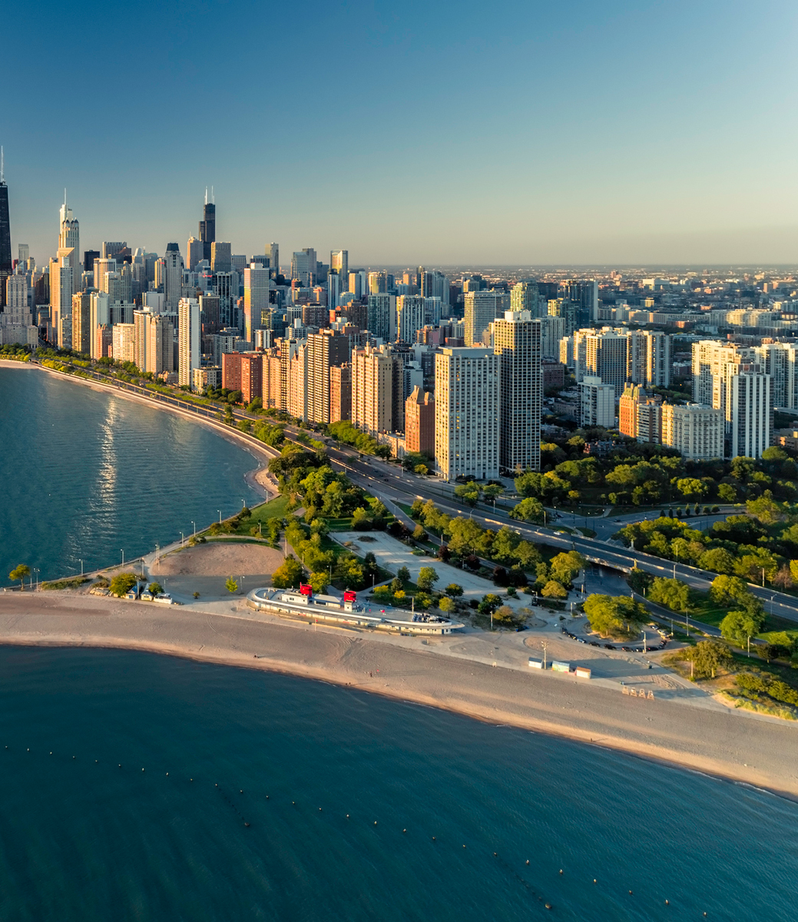
Purpose
Inspired by these articles concerning precipitation effects on the Chicago river and Lake Michigan, we set out to predict one serious consequence of a changing climate. By training a machine algorithm to analyze weather data (rainfall, air temperature, and water temperature) and incidence of e. coli in beaches, we hope to better predict how precipitation can affect waterborne diseases as well as protect beachgoers.

Slide 3
Process
Brainstorm ideas for the project
Decided what data to use
ETL (Extract, Transform and Load) the data
Build the Machine Learning algorithm
Build data base
Create Python App
Create the HTML
Deployed the App

Slide 4

Brain Storming
Looking further into machine learning and deep learning we though the following ideas for the project:
Using Machine Learning to cartoonify real images
Using Machine Learning for sign recognition
Using Machine Learning to predict credit card approval
Environmental and health ideas. Using Machine Learning to predict the levels of E. Coli in the Chicago beaches.
This Photo by Unknown Author is licensed under CC BY-NC

Slide 5

Decision making
Chicago Summertime is critical, and we all enjoy the beach, but we wanted to make sure the beach we go to is safe for us. E. Coli is a dangerous germ, and swimming in waters with a high presence of this germ is not a wise choice. Our model aims to predict the presence of E. Coli in Chicago beaches water using machine learning.
This Photo by Unknown Author is licensed under CC BY

Slide 6

ETL
Extract
Based on this, we gather three primary data sets. Here are the sources of the data we decided to use:
https://data.cityofchicago.org/Parks-Recreation/Beach-Lab-Data/2ivx-z93u
https://data.cityofchicago.org/Parks-Recreation/Beach-Lab-Data/2ivx-z93u
https://water.weather.gov/ahps/
This Photo by Unknown Author is licensed under CC BY-SA-NC

Slide 7
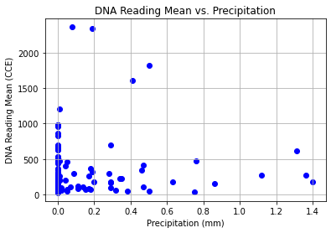
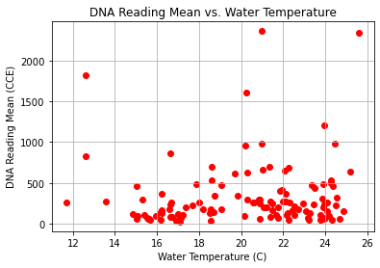
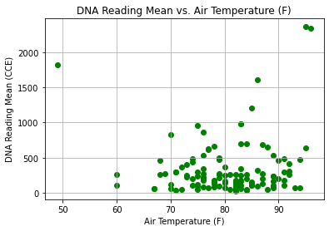
Looking at correlations
Below is scatter plots of each weather variable to E Coli reading levels:

Slide 8
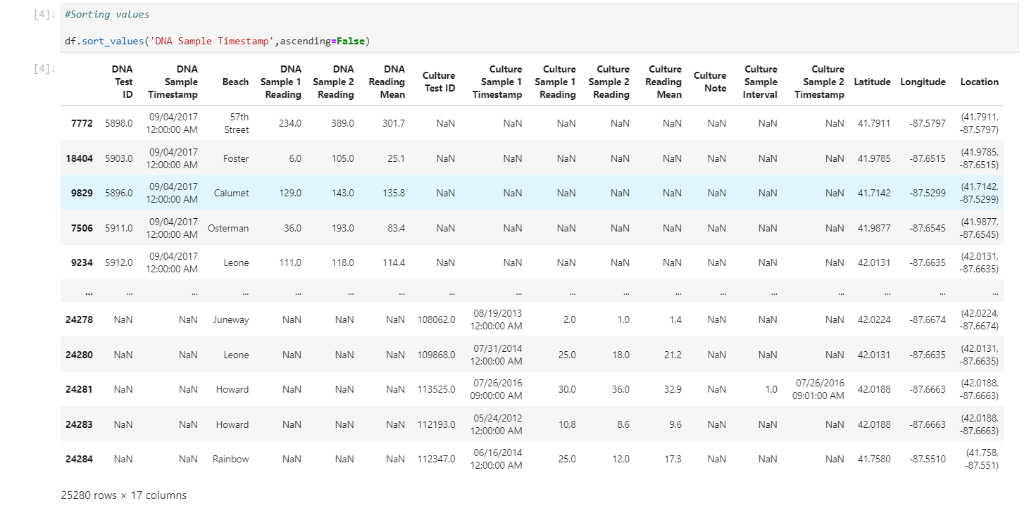
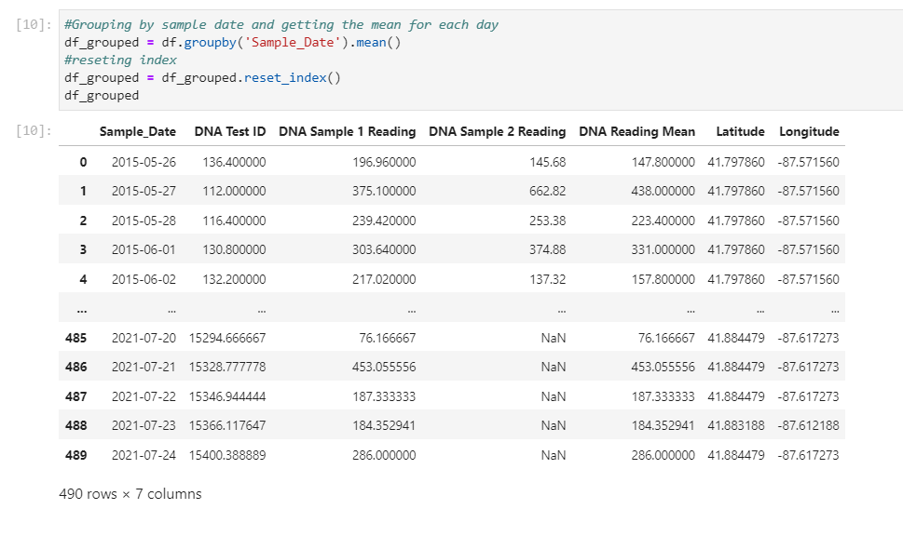
ETL Transform

Slide 9
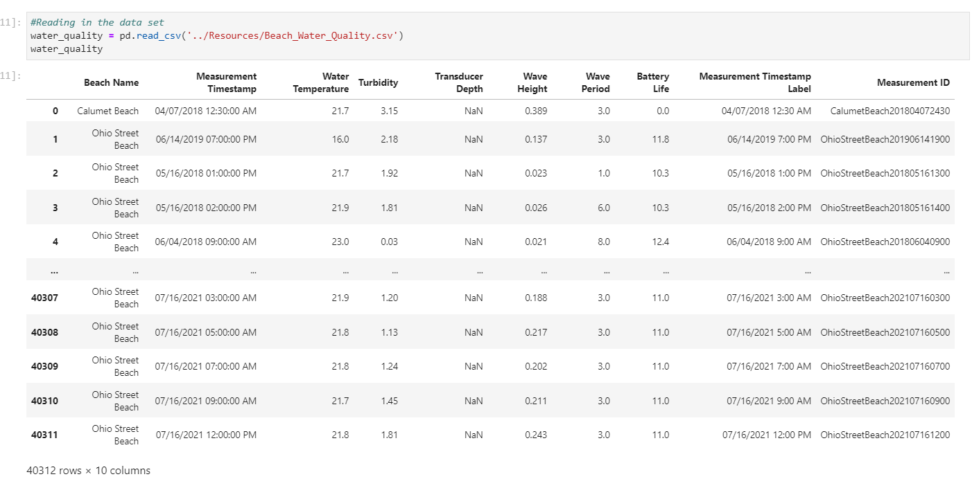
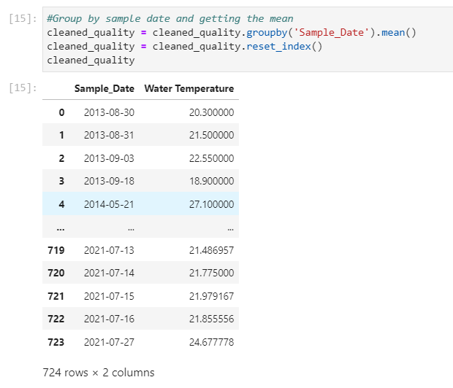
ETL Transform

Slide 10
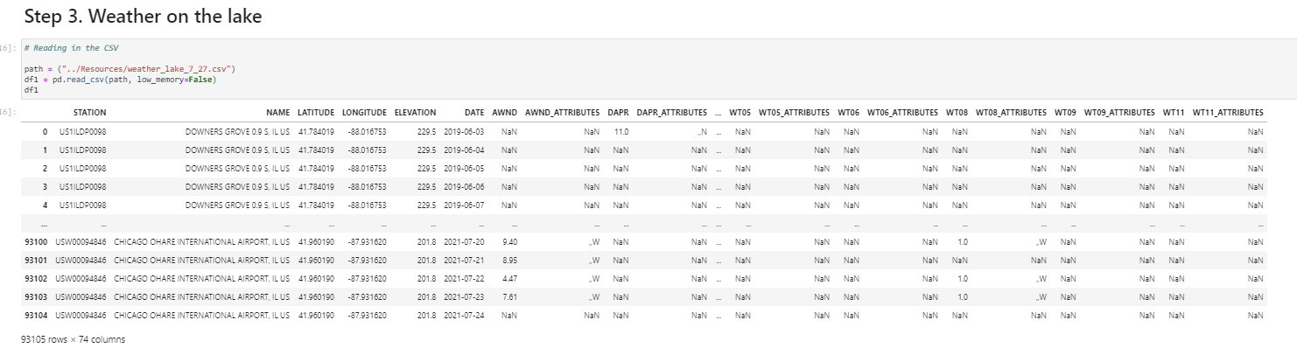
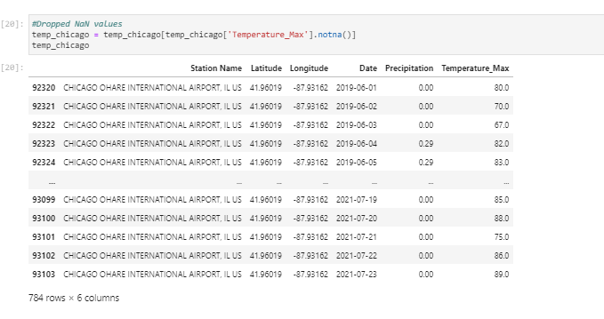
ETL Transform

Slide 11
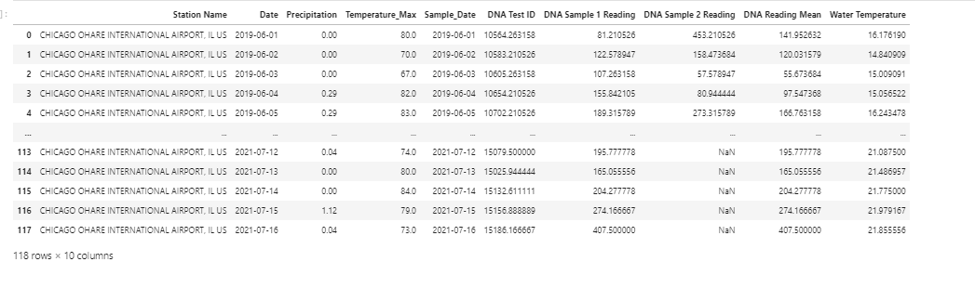
Final df

Slide 12
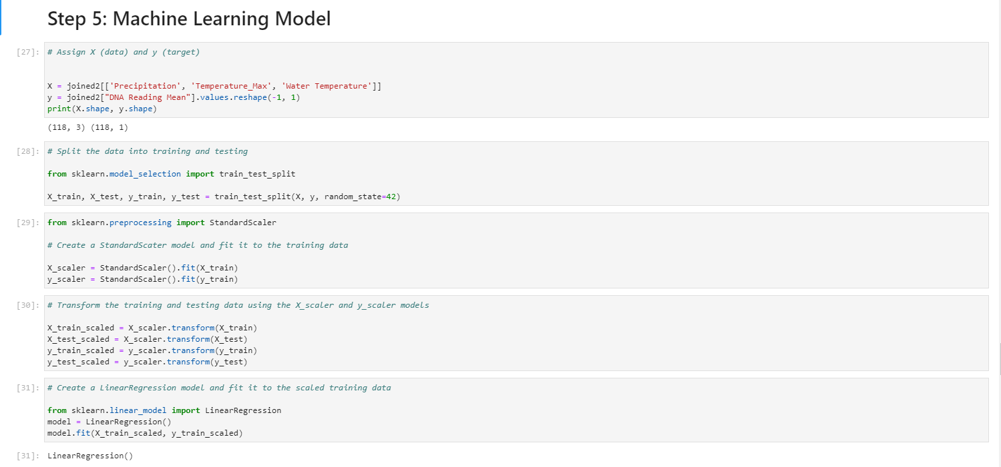
Machine Learning model

Slide 13
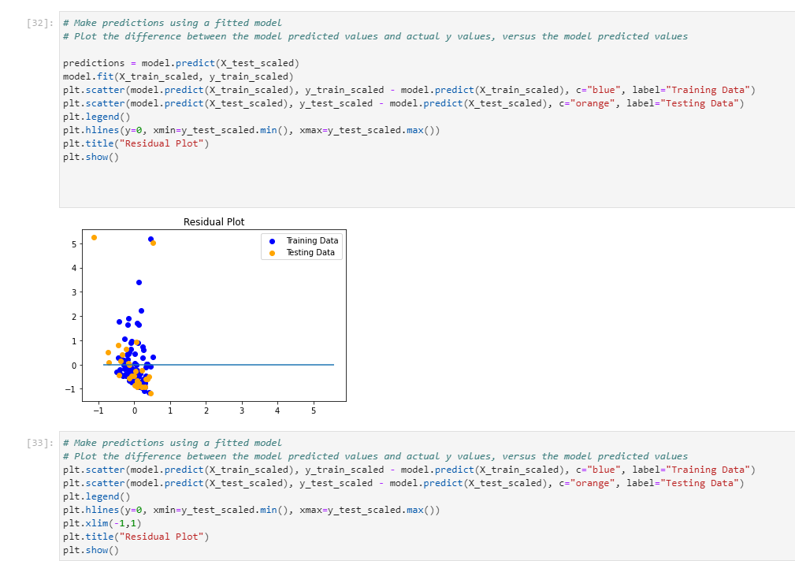
Machine Learning model

Slide 14
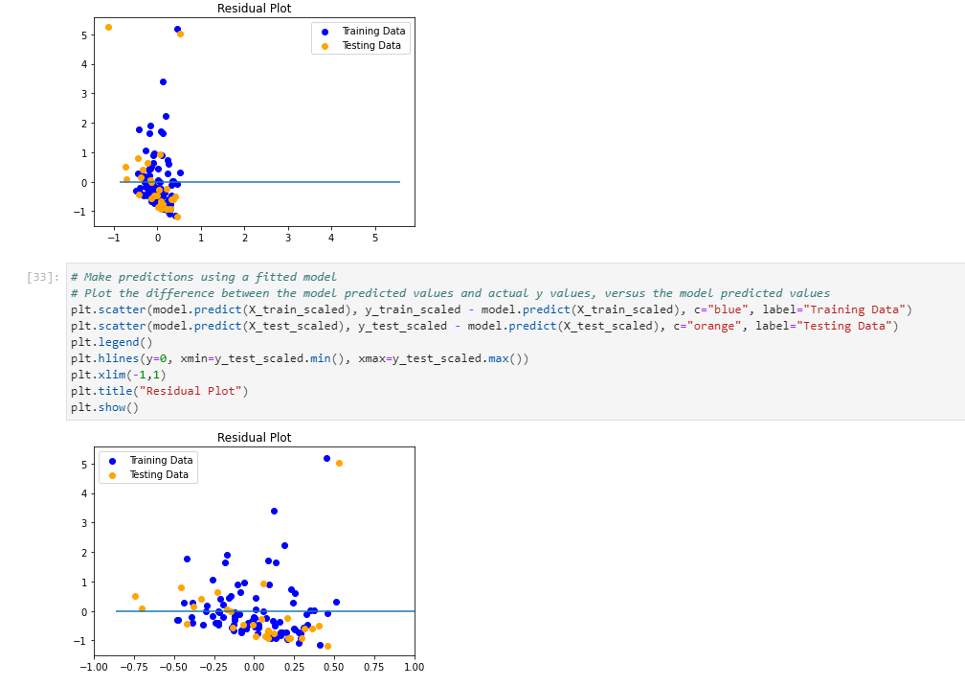
Machine Learning model
By joining the three weather variables and the resulting E Coli reading levels into one dataset, we were able to create a linear regression model. Below shows the plot on difference between the model predicted values and the training/test data:

Slide 15
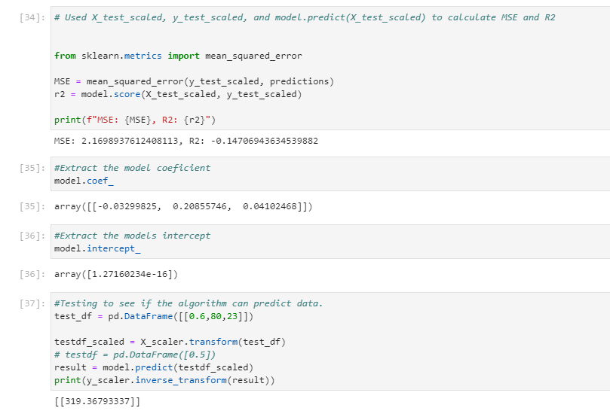
Machine Learning model
The mean standard error and R2 values for the prediction model is shown below:

Slide 16
Build the data base

Slide 17
Python app

Slide 18
html

Slide 19
deployment

Slide 20
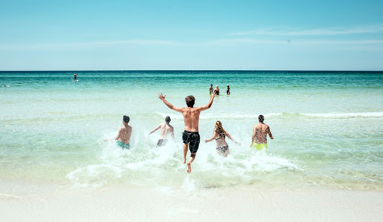

Chicago Enjoy the Beaches safely
This Photo by Unknown Author is licensed under CC BY-NC-ND

